Slide 1
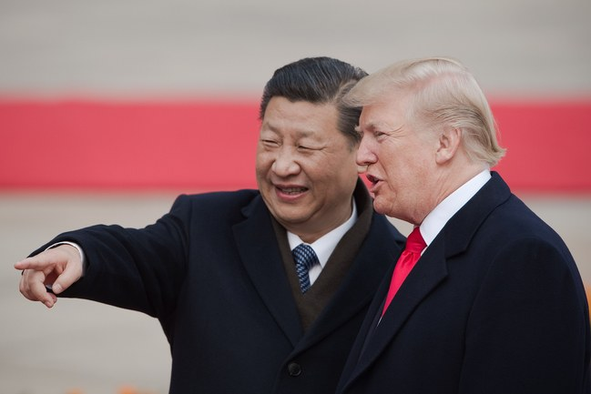
Is China Winning the Trade War ?
https://www.newyorker.com/news/our-columnists/why-china-is-winning-the-trade-war

Slide 2
Is China Winning the Trade War ?
https://www.newyorker.com/news/our-columnists/why-china-is-winning-the-trade-war

Slide 3
Distributed Representation of Chinese Collocation
Bo Xia and Endong Xun

Slide 4
Introduction

Slide 5
What is collocation?
Introduction

Slide 6


Slide 7
decrease to
die out
in peace
burst into laughter
appreciate doing sth
before long
for sure
in relief
according to
have an effect on
decrease
loss
in danger of
protect A from B
long before
come into being
so that
pat attention to
in such a short time
succeed in doing sth

Slide 8
Why collocation is meaningful for us?
Introduction

Slide 9
How to represent a collection?
Introduction

Slide 10
Basic Notions

Slide 11

Basic Notions

Slide 12
Model Architecture

Slide 13
The objective of Collocation prediction
Model Architecture

Slide 14
Continuous Skip-gram Model
Model Architecture

Slide 15
A combination of ontology and hierarchical softmax
Model Architecture

Slide 16
Experiment

Slide 17
Experimental setup
Experiment

Slide 18
Neighbors of one collocation
Experiment

Slide 19
Measuring collocation intensity
Experiment

Slide 20
Verb-verb phrase recognition
Experiment

Slide 21
Conclusion and future work

Slide 22
Distributed Representation of Chinese Collocation
Bo Xia and Endong Xun
Beijing language and culture university
https://github.com/xiabo0816/Chinese_MWEs_Representation

Slide 23
Distributed Representation of Chinese Collocation
Bo Xia and Endong Xun Beijing language and culture university

